Slide 1
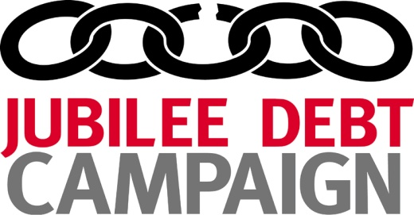
Key debt concepts

Slide 2
Webinars
Key debt concepts: Today!
World Bank and IMF data sources: 18 September
Other debt information sources
Private debt and balance of payments

Slide 3
What we will cover today
External and domestic debt
Debt indicators: Debt to GDP v debt payments to revenue
Types of creditors
Bonds and syndicated loans
Concessional and non-concessional loans
Contingent and realised liabilities

Slide 4
1. External, domestic, currency
External or domestic = where the creditor is based
Foreign currency or local = what currency the debt is owed in
  External has balance of payments risk whatever currency it is owed in
  Foreign has currency risk whoever the debt is owed to

Slide 5
1. External, domestic, currency
 | External | Domestic
Foreign-currency | Eg, debt owed to World Bank, China, Eurobond owned by European bank | Eg, Eurobond owed to a Zambian bank
Local-currency | Eg, kwacha denominated bond owed to European bank | Eg, kwacha denominated bond owed to Zambian bank

Slide 6
2. Debt to GDP or debt payments?
Debt as a percentage of GDP is a poor guide to debt levels as takes no account of:
  The interest rate on the debt
  When the debt is due to be paid
  How much GDP government is collecting in tax revenue
  The currency the debt is owed in
  Who the debt is owed to (external or domestic)

Slide 7
2. Debt to GDP or debt payments?

Slide 8
2. Debt to GDP or debt payments?

Slide 9
2. Debt to GDP or debt payments?

Slide 10
2. Debt to GDP or debt payments?
Government of Pakistan can borrow at 13% interest rate (in foreign currency)

Slide 11
2. Debt to GDP or debt payments?
Government of Pakistan can borrow at 13% interest rate (in foreign currency)
Government of Japan can borrow at -0.3% interest rate (in local currency)

Slide 12
2. Debt payments
Debt service = principal + interest + charges
Principal = Amortization
Interest + charges

Slide 13
2. Debt to GDP or debt payments?
Debt payments as a proportion of government revenue
  Includes interest
  Is measure of the burden on the government
  But:
  Projections into the future can only ever be estimates
  Principal payments not an issue if they can be refinanced with new loans
External debt payments as a proportion of exports
  Shows impact of debt payments on financial relationship with rest of the world

Slide 14
3. Categories of creditors
Multilateral – (IMF and World Bank but also various other less well known)
Bilateral – other governments (Paris Club, non-Paris Club)
Private – bonds, commercial bank loans, others

Slide 15
3. Categories of creditors

Slide 16
4. Bonds
A bond is an easily tradeable debt
Coupon = interest
Price = what buyers pay now, as a percentage of the face value
Yield = the return the buyer will get [from debtors point of view is a guide to what interest rate lenders would now charge]

Slide 17
4. Zambia’s bond prices

Slide 18
4. Zambia’s bond prices

Slide 19
4. Bank loans and syndicated loans
Bonds are not the only form of loan from the private sector
Direct bank loan, syndicated loan means more than one bank involved
These loans can still be sold to other creditors

Slide 20
5. Concessional and non-concessional
Concessional = no clear definition. Lower interest rate than can borrow from private markets.
Non-concessional = what private sector will charge, but this unique to time and place
Grant element = should be a measure of the cost to the lender, but high discount rates used in calculations mean lenders can make profit from ‘concessional loans’

Slide 21
5. Example
World Bank loan to Zambia:
  Payable over 30 years
  Interest rate 2%-2.89%
  Claimed grant element 27%
  But World Bank can borrow at 1% to 2%
Bilateral loans likely to have higher interest rate than World Bank, but still be called concessional

Slide 22
6. Contingent and realised liabilities
Contingent = government might have to pay if something happens
Realised = government will have to pay, but is not debt in a traditional way

Slide 23
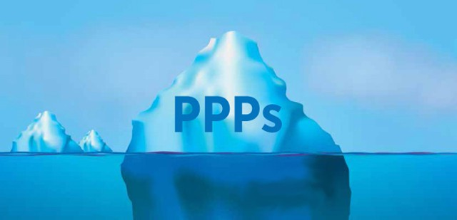
6. Contingent and realised liabilities
Contingent = government might have to pay if something happens
Realised = government will have to pay, but is not debt in a traditional way

Slide 24
Questions?
Tim Jones, Head of Policy, Jubilee Debt Campaign UK
tim@jubileedebt.org.uk
Next webinar 18 September

